Slide 1
TRAVERSING THE AMERICAN CAREER LADDER
Presentation by Abi Godfrey

Slide 2
ABI GODFREY BIO
I entered the workforce at age 16 but I started my career about 10 years ago. Over those years I have re-achieved a manager position 4 times. A graduate of the University of Texas in Austin and later a Masters at Florida Tech Institute. Received such achievements as PMP, ACP, and CSM. Became a Competent Communicator within Toastmasters. Currently working as Corporate Systems IT Manager at Kinder Morgan.

Slide 3
PRESENTATION OVERVIEW
Promote yourself
Keep a fresh resume
Continue learning
Take a role that scares you
Demand a career path
Follow-up on your Career - Ask instead of assuming

Slide 4
PROMOTE YOURSELF
Bring up your success
Offer insight on your expertise
Let social promote you
Join the conversation

Slide 5
UPDATE YOUR RESUME
Every 6 months polish your resume
Search for a job
Connect with peers

Slide 6
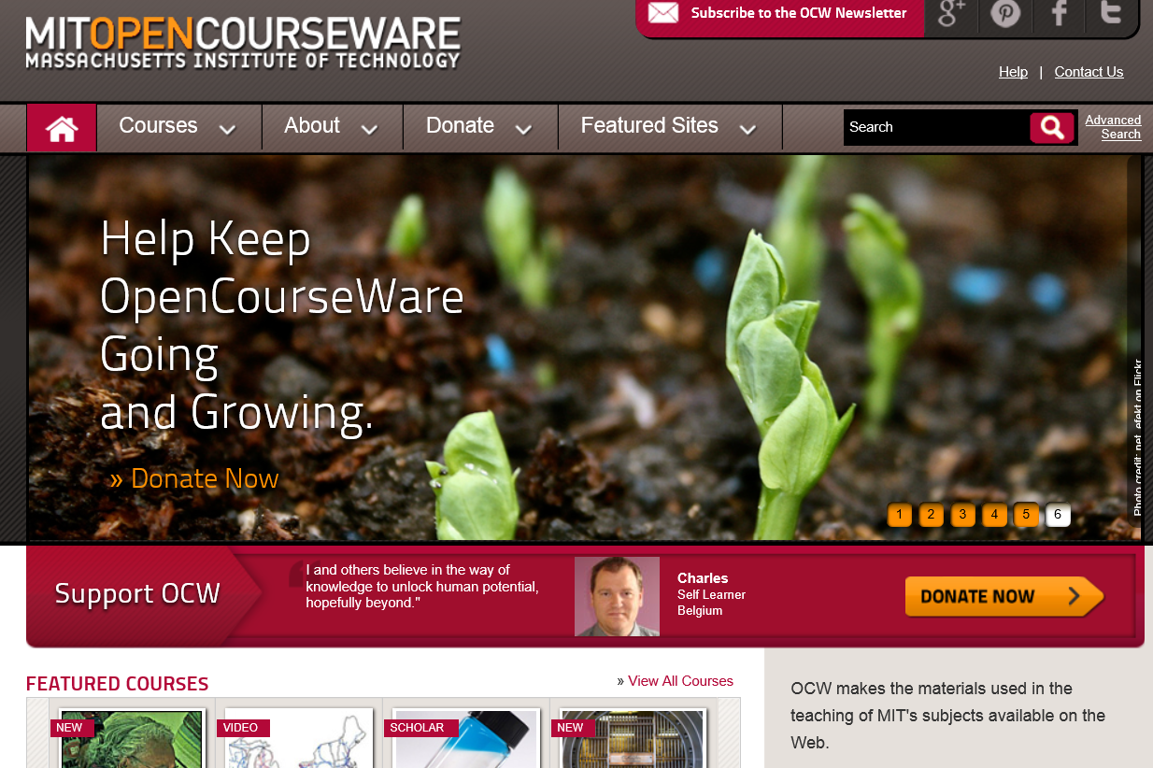
CONTINUE LEARNING
On the job learning
Virtual learning
Find a new hobby

Slide 7
TAKE A ROLE THAT SCARES YOU
Every 3 – 5 years take a challenge
New job
New role
New project

Slide 8
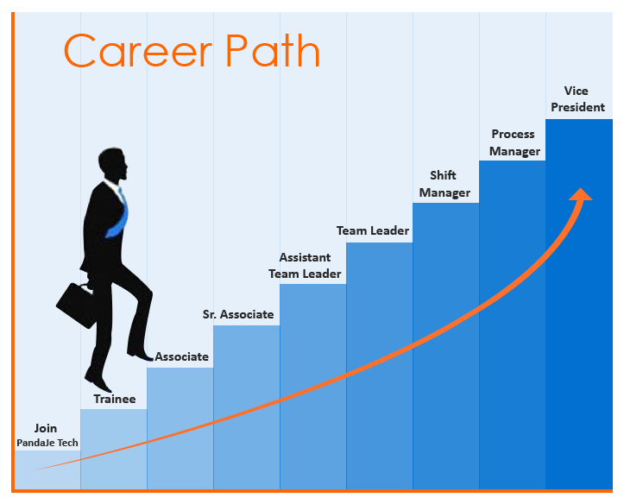
DEMAND A CAREER PATH
Discuss company roles with peers
Ask your boss about your career
Be transparent with your shortcomings

Slide 9
FOLLOW-UP ON YOUR CAREER ASK INSTEAD OF ASSUMING
Tell your boss when you meet milestones
Ask for help
Check in on next steps and timelines

Slide 10
Q & A
Abigayle Godfrey
Abi.stallings@gmail.com

